Slide 1

Bitcoin forecasting
A deep learning approach
July 17th 2022
Mohamed MZAOUALI

Slide 2
outline
Introduction
Exploratory Data Analysis
Feature Engineering
Model Selection
Model Summary
Data Analytics
Conclusion
References

Slide 3
Introduction
Objective:
Time series forecasting
Data Source:
LSTM (Long Short-Term Memory) Model
Daily trading data of Bitcoin between 2014 to 2021.

Slide 4
EDA
DATA SET:
Shape:
Null Values:
Missing Values:
NaN Values:
Independent Variables:
5 numerical features.
Dependent Variable:
'Close' Column with correspond to the daily closing price of BTC
2663 Lines by 6 Columns.
None.
None.
None.

Slide 5
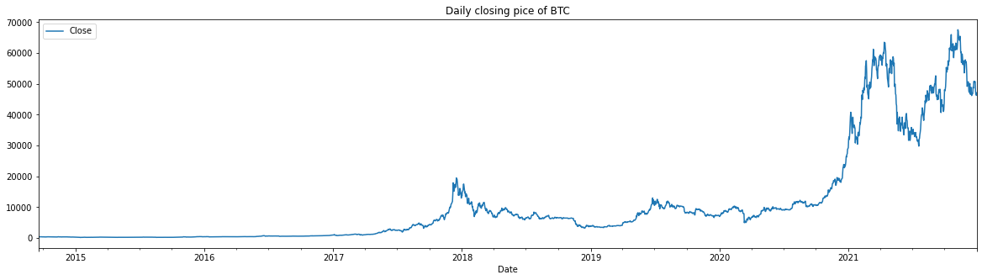

Slide 6
Feature engineering
Data Cleaning
3 D Reshape
NaN, Na & Null Values.
Scaling features
MixMax Scaler
Splitting Data
(NumberOfExamples, TimeSteps, FeaturesPerStep)
365 Obs as testing set
2298 Obs as training & validation set

Slide 7
Model selection
LSTM Model
Activation function: SWICH
Optimizer: ADAM
Results
1.92% of MAPE
Very Hight predictive power

Slide 8
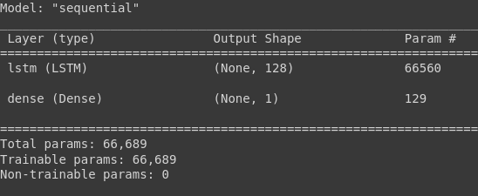
Model summary

Slide 9
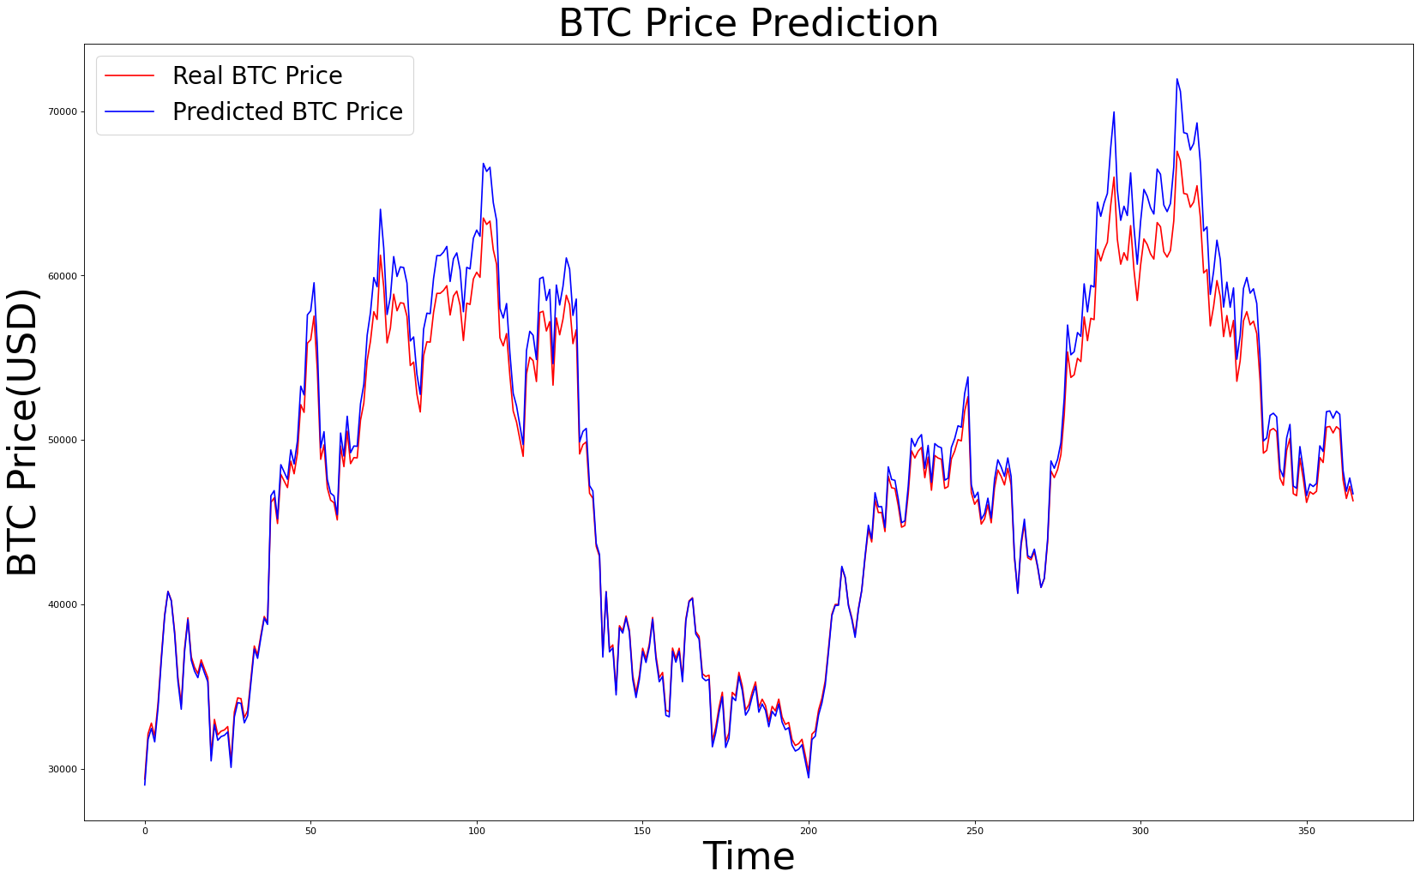
Data Analytics
Mean Absolute Percentage Error (MAPE) = 1.92%

Slide 10
Conclusion
LSTM success
Swish Activation function
Future Improvement
Online & Realtime focasting

Slide 11
Reference
The full approach is presented in the following ipynb:
https://github.com/mzaoualim/Coursera_IBM_Machine_Learning_Professional_Certificate/blob/main/Deep%20Learning%20and%20Reinforcement%20Learning/Project_BTC_LSTM.ipynb

